Slide 1
International Urban cooperation
Cundinamarca – bogotá & lazio region
Carlo Rossi c.rossi@regione.lazio.it

Slide 2
OUTLINE
1
2
Pairing objective
Main milestones
3
4
priorities
Transformative activities
5
6
Key actions
timeline
7
8
LESSONS LEARNED
Dos & don’ts
Notes:
Carlo

Slide 3
PAIRING OBJECTIVE
01

Slide 4
Pairing OBJECTIVE
Sharing knowledge, skills and best pratices within the Lazio challenges and the areas of specialization in the context of regional smart specialization strategy (R3S)
Results and impacts achieved:
Shared documents on main sectors and topics of common interest
Exchange of experiences of the selected areas of specialization/interest (during the two Missions)
Mobilised and worked with national and local stakeholders (mainly national research centers)
To be achieved
Making agreements and memoranda of understanding
Planning future/next thematic meetings and training
Exchanging of professionals, students and researchers
Technology transferring
Developing joint commercial enterprises
Life Sciences
Agrifoods - Dairy
Creative Industries
Notes:
Carlo

Slide 5
MAIN MILESTONES
02

Slide 6
MILESTONES
1st Mission: June 25th – 29th (Rome, Italy)
Focus on specific regional node of exellence:
Agrifood, biotechnology for health, thematic cluster and technological district
Involve in Pairing project National Research Centers in a Multistakeholder approach (involving public and private sector operators, productive and enterprise system, academia )
2° Mission: October 1st – 5th (Bogotá, Colombia)
Focus on national and regional research and quality institutions:
Agrifood, bio(nano)technology for cosmetics and health, energy efficiency
Notes:
Daniel

Slide 7
PRIORITIES
03

Slide 8
PRIORITIES
Biodiversity
Agrindustry/Agrifood: Focus on DAIRY and Gastronomy
Energy and new materials
Buffalo chain: processing meat and milk
Life sciences: new tech. for health, pharma, cosmetics.
NICHES OF MUTUAL INTEREST
Cluster Governance
Notes:
Daniel

Slide 9
TRANSFORMATIVE Activities
04

Slide 10
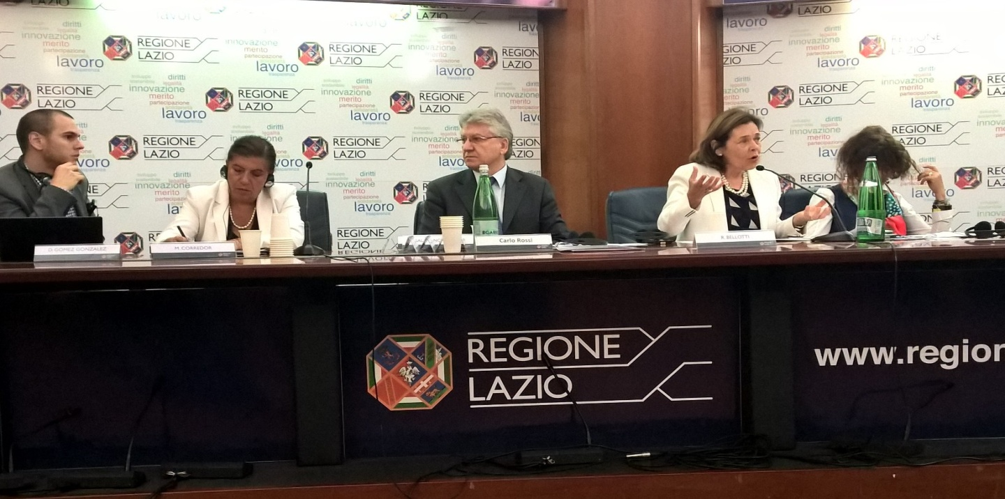
TRANSFORMATIVE ACTIVITIES
Study meetings on topics identified above mentioned
Workshops to deepen the subjects of cooperation with the pairing partner
Guided visits to selected research laboratories and demonstrator machinery
Notes:
Carlo

Slide 11
Activities during the 1ST mission
Workshop organized together with CREA Research Center «Foods and Nutrition»
Notes:
Carlo

Slide 12
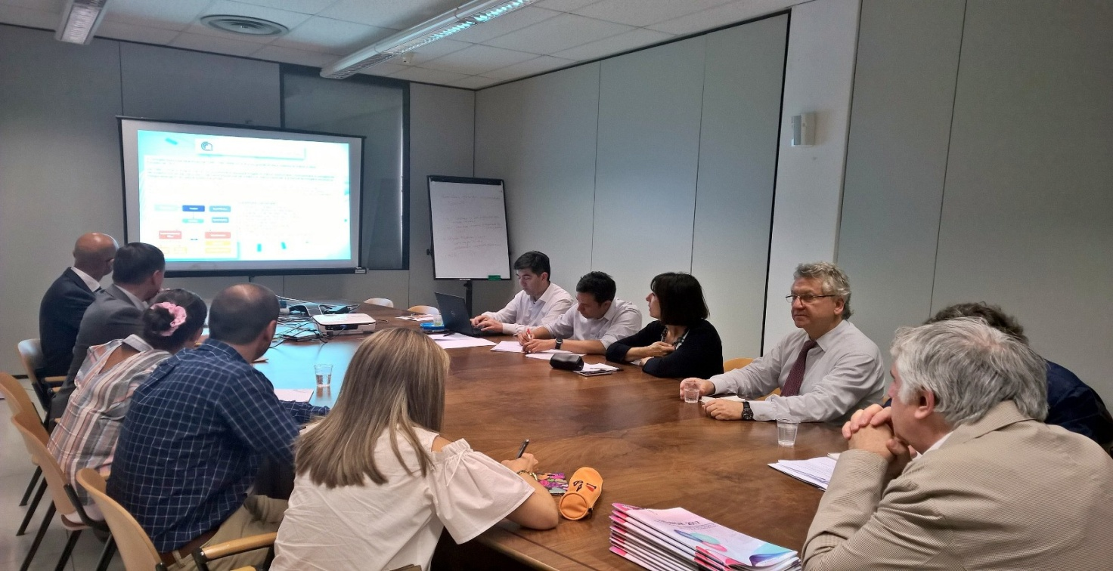
Activities during the 1ST mission
Meeting and visit laboratories in CNR - National Center for Research: Department of structure of materials – Rome
Notes:
Carlo

Slide 13
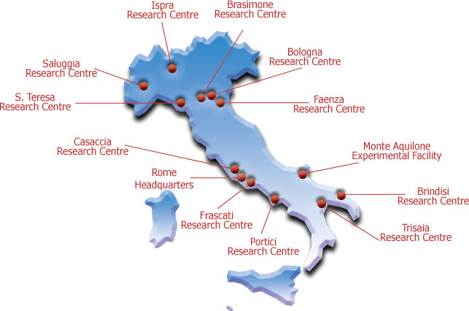
DEPARTMENT NUCLEAR FUSION AND TECHNONOLOGY FOR NUCLEAR SAFETY
DEPARTMENT ENERGY EFFICIENCY
DEPARTMENT ENERGY TECHNOLOGIES
DEPARTMENT FOR SUSTAINABILITY OF PRODUCTION AND TERRITORIAL SYSTEMS
Efficient Use of Resources and closing cycles
Technologies and processes materials for sustainability
Models and technologies to reduce human impacts and natural hazards
Protection and enhancement of the territory and natural capital
Biotechnologies and Agro-Industry
Technologies and methodologies for the protection of health
Notes:
Carlo

Slide 14
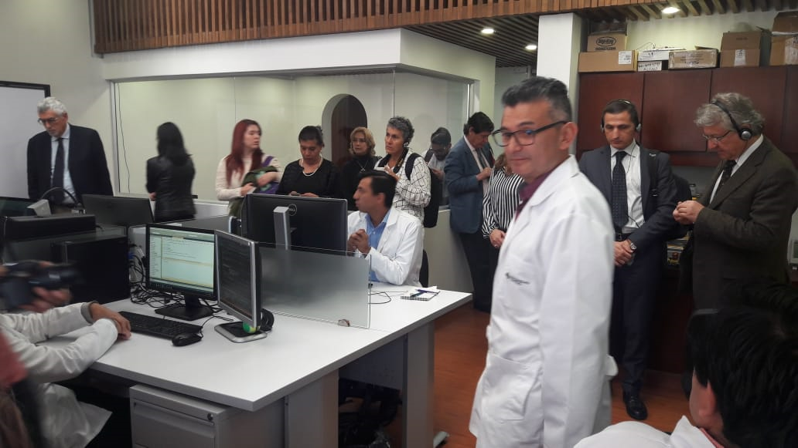
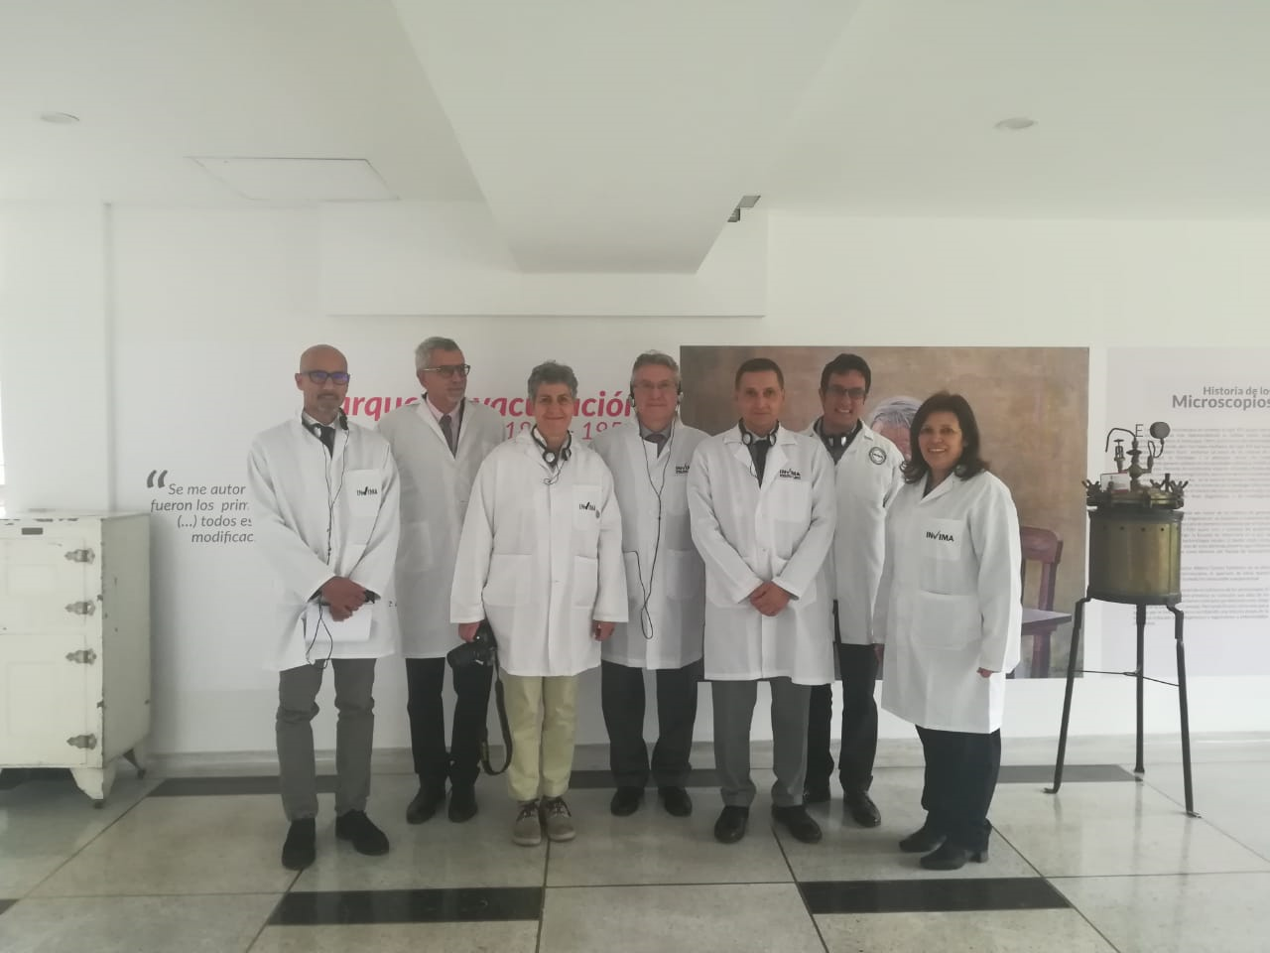
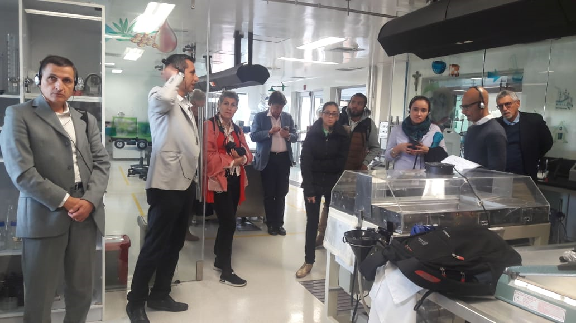
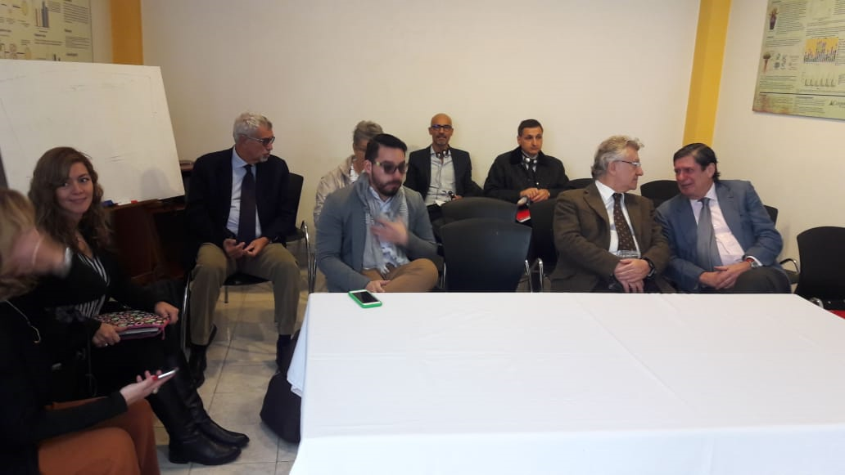
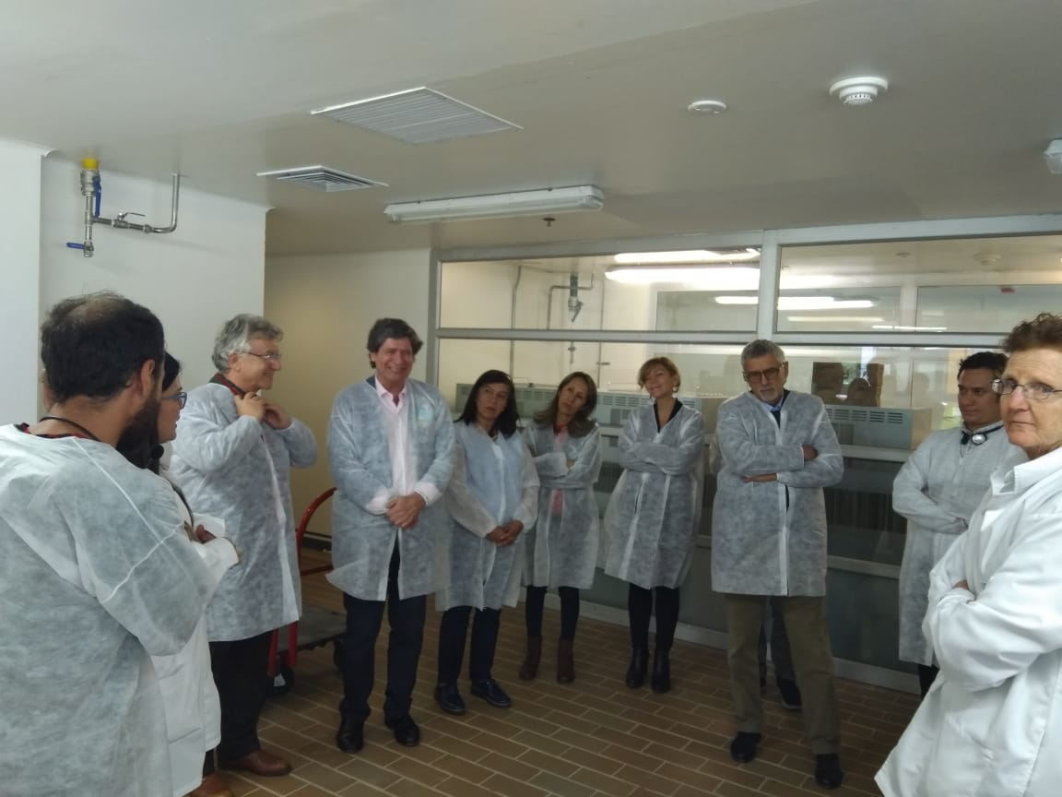
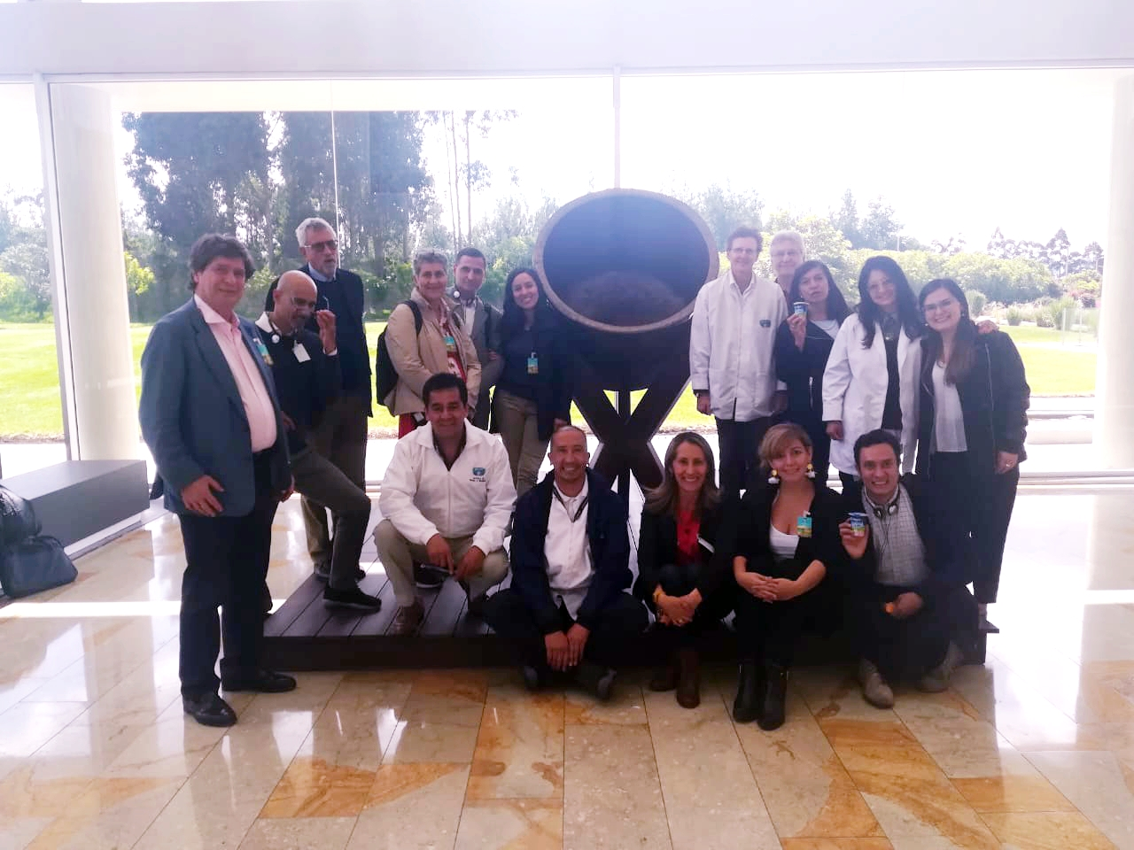
Activities during the 2ND mission
BioNanotech Center – Central Univ.
Invima
Universidad de la Sabana
CORPOGEN
Instituto de Investigación de la empresa Alpina
Notes:
Daniel

Slide 15
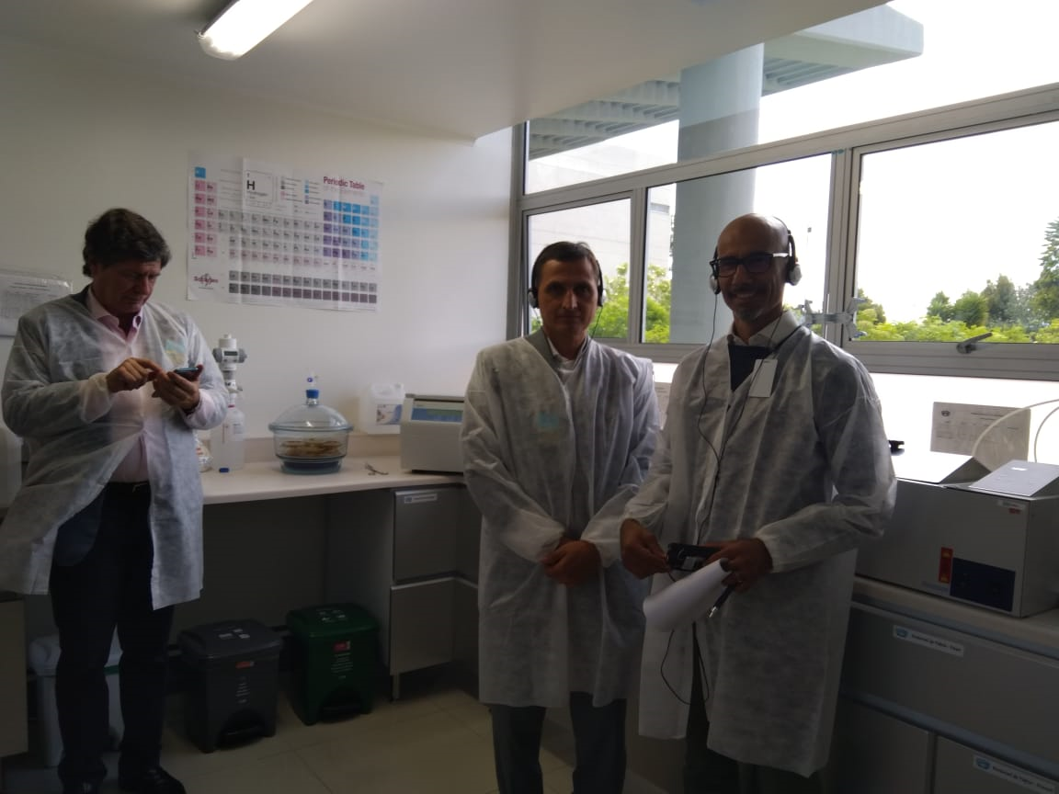
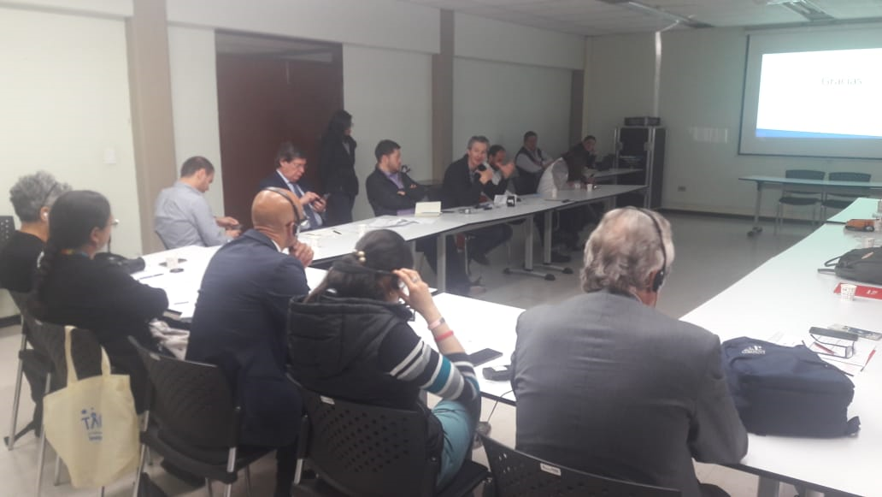
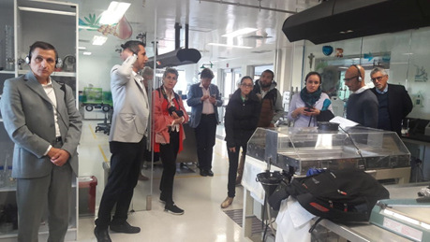
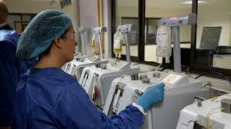
Activities during the 2ND mission
Instituto de Biotecnología Universidad Nacional
Instituto Colombiano Agropecuario - ICA
Instituto de Ciencia, Biotecnología e Innovación en Salud (IDCBIS)
Agrosavia
Notes:
Daniel

Slide 16
KEY ACTIONS
05

Slide 17
KEY ACTIONS
Key actions to be taken:
LoA, MoU, etc; Involve private sector; Help to develop business
Draw up a possible pilot project
Responsibilities:
Lazio Region: Identify EU funds and instruments, applying specific call launched by EU Commision
Bogotá-Cundinamarca: Identify local funds and instruments, as well as identify possible national and regional actors to involve in a pilot project
Notes:
Carlo

Slide 18
TIMELINE
06

Slide 19
TIMELINE
Main Milestones | Sector / Area / Theme | Pairing Objective : SHARING Knowledge and Skills |  |  | Timeline (1 year)
 |  |  |  |  | M1 | M2 | M3 | M4 | M5 | M6 | M7 | M8 | M9 | M10 | M11 | M12
milestone | Sector / Area / Theme 1 | Overall objective of the pairing action
milestone
milestone
milestone
milestone
milestone
milestone
Key objective of the Pairing Action | Sector / Area / Theme | Priorities | Transformative Activies | Actions | Timeline (1 year)
 |  |  |  |  | M1 | M2 | M3 | M4 | M5 | M6 | M7 | M8 | M9 | M10 | M11 | M12
Overall objective of the pairing action | Sector / Area / Theme 1 | Priority 1 | Transformative activity | Action
 |  |  |  | Action
 |  |  | Transformative activity | Action
 |  | Priority 2 | Transformative activity | Action
 |  |  |  | Action
 |  |  | Transformative activity | Action
 |  | Priority n | Transformative activity | Action
 |  |  |  | Action
 |  |  | Transformative activity | Action
 |  |  |  | Action

Slide 20
LESSONS LEARNED
07

Slide 21
LESSONS LEARNED
Cooperation among regions of different countries, cultures and paradigms implies (could determine) great opportunities to activate growth processes and local development.
A direct comparison of ideas, techniques, products, processes establishes an adequate premise for the beginning of international cooperation between the pairing countries.
It is essential to cooperate and plan with a multi-stakeholder approach.
Cooperation in the framework of RIS3 commonalities facilitates the process of identifying possible areas of collaboration, particularly through parallel technologies.
Notes:
Daniel

Slide 22
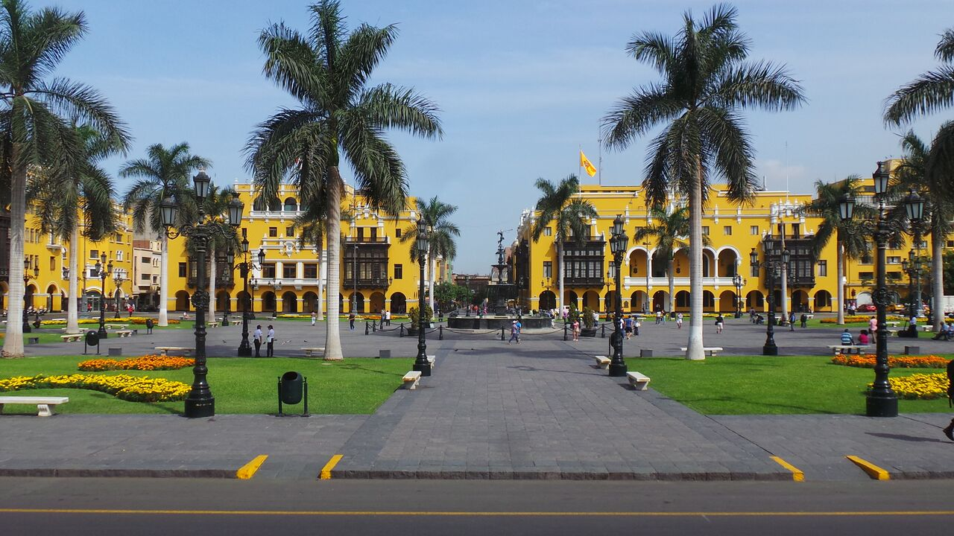
DOS & DON’TS
08

Slide 23
DOS & DON’TS
To flourish and achieve actual results and impacts in the region pairing:
It is fundamental to enhance opportunities to meet and deepen the common interests in order to identify possible intervention niches and support pilot actions aimed at developing the local production system.
Extend pairing period and foresee targeted actions for possible technological transfer, strengthening entrepreneurial capacity, internationalization of services and training.
Lack of funding could be a limit for the implementation of the activities. The programme requires an extension: exchange activity should be protracted at least to two years, with the possibility of involvement of entrepreneurial activities and the start-up system.
Notes:
Carlo

