Slide 1
International Urban cooperation
C1: COOPERATION BETWEEN CITIES (LA & EU): CONSORCIO GRANDE ABC + TORINO
Name 1 & Fabrizio Arneodo|| email 1 & fabrizio.arneodo@5t.torino.it
Name 2 & Paulo Benites|| email 1 & paulo.benites@globace.com.br

Slide 2

OBJECTIVES OF ACTION PLAN
Main objectives
Design of public policies to promote sustainable urban mobility
Transfer and adaptation of technologies for the integration of local transport systems
Development of the concept of MaaS – Mobility as a Service
Expected results and impacts
Improved governance at local level in providing transport services
Increase the average speed of traffic in ABC -> improved air quality
Promote the use of public transport and reduce the use of private cars

Slide 3
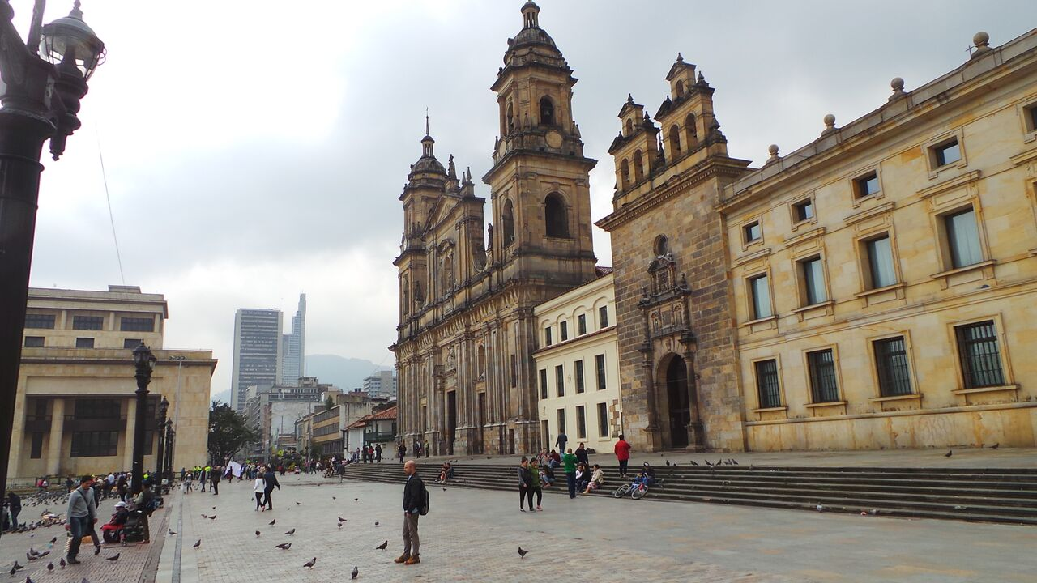
MILESTONES FOR RESULTS
Main milestones leading to results
Specification of integrated ticketing system
Development of a MaaS concept
Technological integration on the model of City of Torino/5T operation center and ICT technologies
Deep knowledge of the transport demand and users habits – Big Data processing
Deployment of applications re-using developments from Torino/5T
Development of new applications to be used by both cities
Institutional integration on the model of the Agenzia per la Mobilità Piemontese

Slide 4
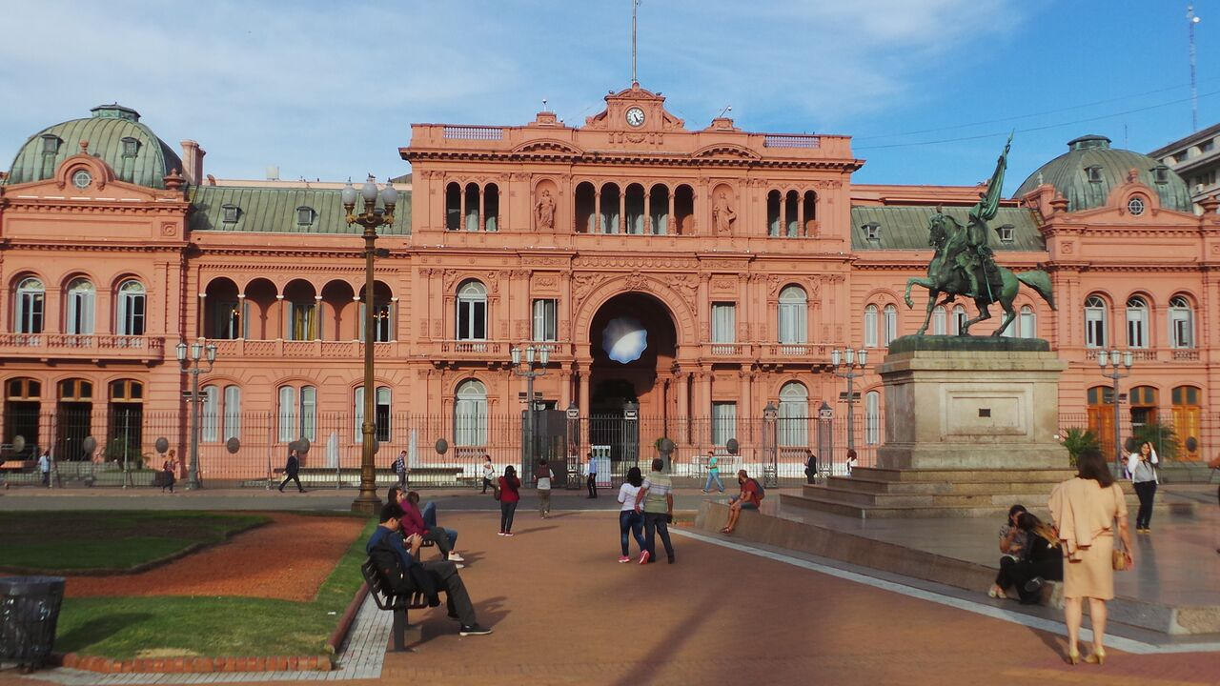
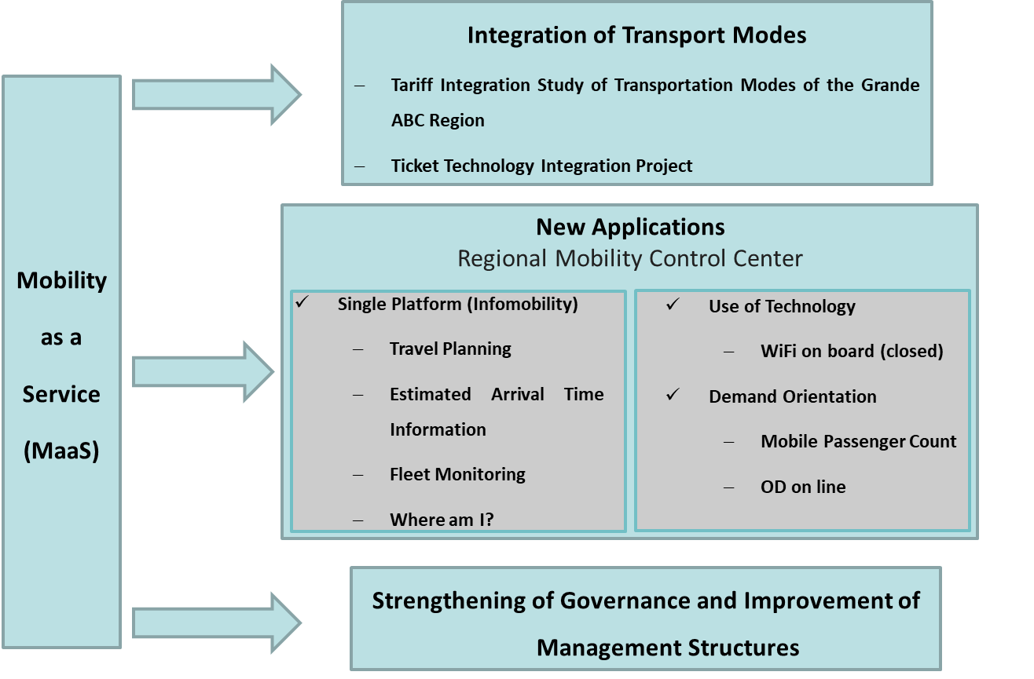
KEY ACTIONS
Key actions

Slide 5

Sources of funding
Projects | GRANDE ABC Own Budget (EUR) | TORINO Own Budget (EUR) | Funding Need- IUC (EUR)
1- Tariff Integration + Ticket Technology Integration | 37.500 | TBC | 640.000
2- Design of Regional Mobility Control Center and New Applications
Design of Regional Mobility Control Center | 1.107.500 | TBC | 0
Single Platform – Infomobility | 64.000 | TBC | 414.000
New uses of technology (wifi on board, demand orientation) | 70.000 | TBC | 582.500
3- Strengthening of Governance and Improvement of Management Structures | 132.500 | TBC | 308.000
TOTAL | 1.411.500 | TBC | 1.944.500

Slide 6

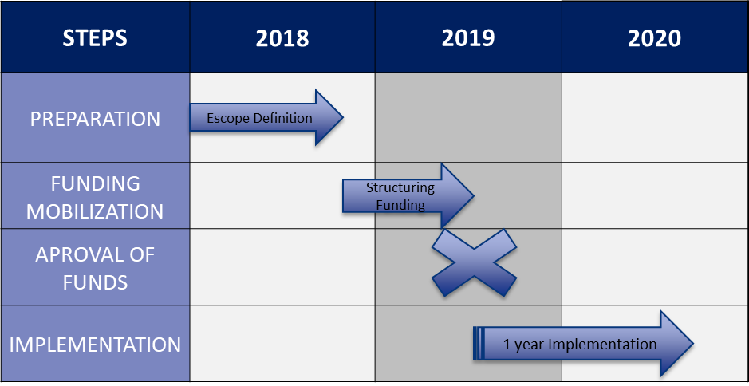
TIMELINE

Slide 7

LESSONS LEARNED
LESSONS LEARNED
The governance of the local stakeholders is fundamental to implement integrated solutions
Understanding the behavior and demands of service users before designing a new solution
Successful experiences/good practices (Torino) can be helpful to promote changes in other contexts (Grande ABC)
Re-use of applications can increase de feasibility
Deploying innovation takes time and investment
Implementation of technology can “jump” steps and promote fast results to Public Transport users

Slide 8

Conclusion + REcommendations
Conclusion + Recommendations
Before implementing the Action Plan, careful feasibility studies and as-is analyses are fundamental – Torino can provide support for methodology
Ad-hoc agencies (independent but supported by local institutions) can be the tool to promote inter-institutional integration and joint action planning
The support of the local community/users is fundamental for the success of all new services. Involvement/participatory methodologies in the design of services shall be considered
Participation of University will bring innovation and dissemination of technologies
Successful integrated approach for public transport in Europe can validate and convince ABC stakeholders the use of similar practices

