Slide 1
International Urban cooperation
C3 PAIRING REGion cioeste & REGION bielsko-biała
Patrycja Węgrzyn & Carlos Abrao|| pwegrzyn@arrsa.pl & abrao.carlos@gmail.com

Slide 2
OUTLINE
1
2
Pairing objective
Main milestones
3
4
priorities
Transformative activities
5
6
Key actions
timeline
7
8
LESSONS LEARNED
Dos & don’ts

Slide 3
PAIRING OBJECTIVE
01

Slide 4
Pairing OBJECTIVE
Establish cooperation for economic development in the area of ICT
to promote internationalisation of companies from both regions
to use the two regions as HUBs to access the Brazilian and Polish markets
to open the Latin America and European markets to both regions

Slide 5
MAIN MILESTONES
02

Slide 6
MILESTONES
Before the first mission in Poland: drafting the cooperation
Kick of meeting – Brussels, November 2017: definition of the mutual intrest and area of cooperation
SWOT analysis of the state of the art: how does the ICT sector looks like in both regions? – questionnaire
First official online conference: city – education – business representatives from both regions
Working in regions: assesment of the questionnaire, indication of firms to be involved in the project
Niches of cooperation: clarification of the areas of mutual intrest

Slide 7
MILESTONES
First mission in Poland – May 2018:
Meetings between te representatives of entities that have expressed their will of cooperation:
Local government
Universities
Start-up and business support environment
Firms
signing the Memorandum of Understanding by representatives of project partners – CIOESTE and ARRSA
Roadmap of cooperation: niches, firms and ways of cooperation indicated

Slide 8
MILESTONES
After the mission in Poland – before the mission in Brazil:
Weekly Skype calls between project partners
Bilateral on-line meetings of firms: CIOESTE and ARRSA as a facilitators of cooperation
Details of the roadmap: towards the action plan
Preparation of the second mission agenda

Slide 9
PRIORITIES
03

Slide 10
PRIORITIES
Internationalisation of local SMEs
Build critical mass by developing knowledge and required skills and capabilities for current and future jobs
Develop an ecosystem that fosters innovation

Slide 11
TRANSFORMATIVE Activities
04

Slide 12
TRANSFORMATIVE ACTIVITIES
Internationalisation of local SMEs
Establish bilateral cooperation between firms of both regions
Develop for CIOESTE an innovation/ competition strategy and an associated plan for entering international markets with support from Bielsko-Biala
Share the methodology of organising international ICT event – following the experience of CIOESTE

Slide 13
TRANSFORMATIVE ACTIVITIES
Build critical mass by developing knowledge and required skills and capabilities for current and future jobs
Establish bilateral cooperation between regional and international universities and research centres
Develop a joint knowledge platform for communication and exchange of business opportunities (i.e. demand and offer) in both regions

Slide 14
TRANSFORMATIVE ACTIVITIES
Develop an ecosystem that fosters innovation
Promote regionally international trend and business ICT events in order to both influence and stay up to date with current and future technological developments
Test new solutions for innovation public policies that stimulates start-ups, accelerators and incubators

Slide 15
KEY ACTIONS
05

Slide 16
KEY ACTIONS
Mapping of the ICT business in both regions
Indication of the niches of cooperation
Regular on-line meetings
Participation in first I.OESTE event – introducing ARRSA to Brazilian entrepreneurs
Bringing together entities interested in cooperaion
Mission in Poland – signing MoU

Slide 17
KEY ACTIONS
Presentation of the companies: bilateral meetings, presentations of products, services
Roadmap of activities
Participation in the second I.OESTE during the Polish mission in Brazil
Giving the opportunity to face-to-face meetings between Polish and Brazilian entrprenuers

Slide 18
TIMELINE
Main Milestones | Sector / Area / Theme | Key objective of the Pairing Action |  |  | Timeline (1 year)
 |  |  |  |  | M1 | M2 | M3 | M4 | M5 | M6 | M7 | M8 | M9 | M10 | M11 | M12
milestone | Sector / Area / Theme 1 | Overall objective of the pairing action
milestone
milestone
milestone
milestone
milestone
milestone
Key objective of the Pairing Action | Sector / Area / Theme | Priorities | Transformative Activies | Actions | Timeline (1 year)
 |  |  |  |  | M1 | M2 | M3 | M4 | M5 | M6 | M7 | M8 | M9 | M10 | M11 | M12
Overall objective of the pairing action | Sector / Area / Theme 1 | Priority 1 | Transformative activity | Action
 |  |  |  | Action
 |  |  | Transformative activity | Action
 |  | Priority 2 | Transformative activity | Action
 |  |  |  | Action
 |  |  | Transformative activity | Action
 |  | Priority n | Transformative activity | Action
 |  |  |  | Action
 |  |  | Transformative activity | Action
 |  |  |  | Action

Slide 19
LESSONS LEARNED
07

Slide 20
LESSONS LEARNED
How to prepare innovation strategy for the region?
How to organise high-level ICT event?
Bringing the knowledge about the regions and role of CIOESTE and ARRSA as a businnes suport organisations to entrepreneurs
Use the trust to our institutions (CIOESTE and ARRSA) as a bridge to build business suport environment in both regions
Use the universities education capacity to keep talents and high-level employees in the regions
Use the international events to make a brand

Slide 21
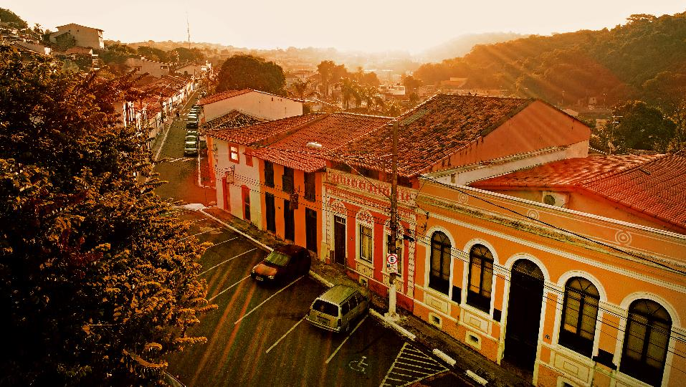
DOS & DON’TS
08

Slide 22
DOS & DON’TS
Follow up projects – information at the begining of cooperation what are the financing possibilities
Budget for the implementation of the project in regions – Staff, promotion, local events etc.
Avoid top-down approach
Our institutions only as a facilitators, not managers of business cooperation

